Slide 1
Project 1

Slide 2
OBJECTIVE OF THIS PROJECT
To create a Jenkins environment with a Jenkins master and a node using terraform.
To create a web application in eclipse and to create a Docker file for this project and add this to Github
Creation of a VM using Ansible and to pull the Docker image from Dockerhub to VM and publish it.
Creation of docker image, vm and docker continer should be done through pipelines in Jenkins

Slide 3
Creation Of Jenkins Environment
Jenkins master and Jenkins build server were created using terraform in Azure.

Slide 4
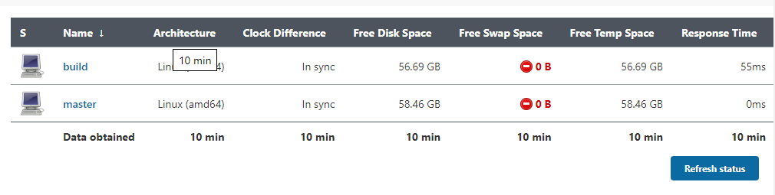
Establishment of Communication
Communication between Jenkins master and build were established.

Slide 5
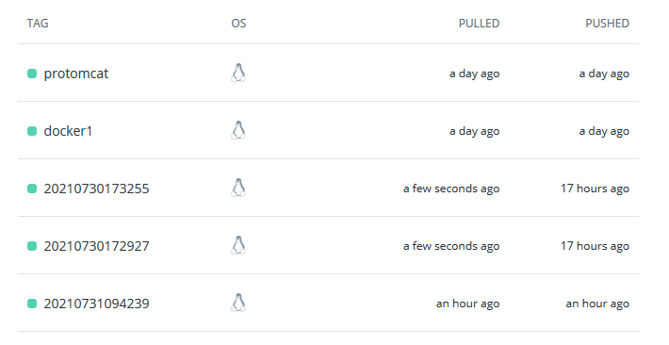
Creation of Docker Image in Pipeline One
The web application which is developed in Eclipse with dockerfile will to added to Github
In Jenkins pipeline one the Dockerfile and web application will undergo maven build then the Docker image will be Build using Docker plugin and published to hub.docker.com.

Slide 6
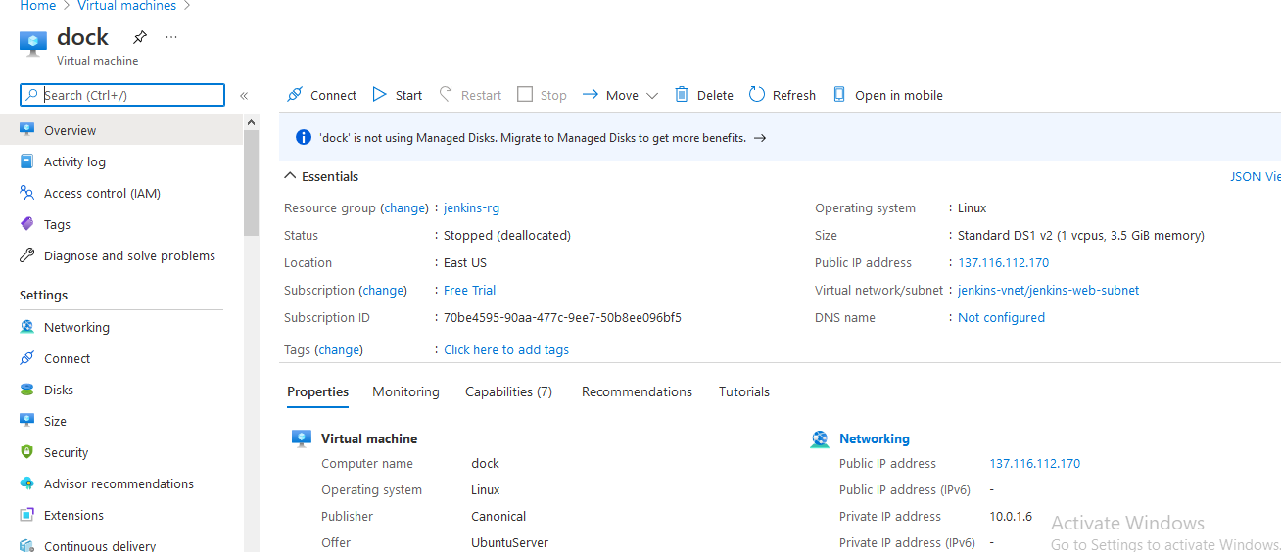
Creation of Pipeline Two.
In Pipeline two we develop an Ansible script to create an Azure VM to create the Docker container in it.

Slide 7
Installation of Docker In VM
Using Ansible, Docker and dependent software will be installed in the Azure VM and docker image will be pulled to this vm and container will be created in the VM.

Slide 8
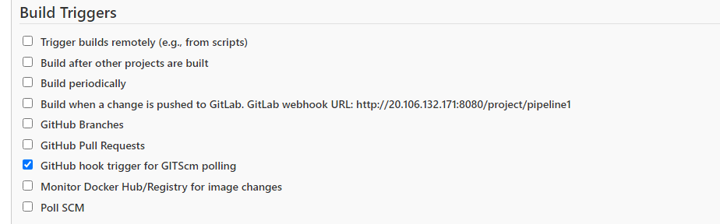
Creation of CI/CD integration.
Creating a parent child pipeline link to to continues integration and adding Github webhook to pipeline one to create continues deployment.

Slide 9
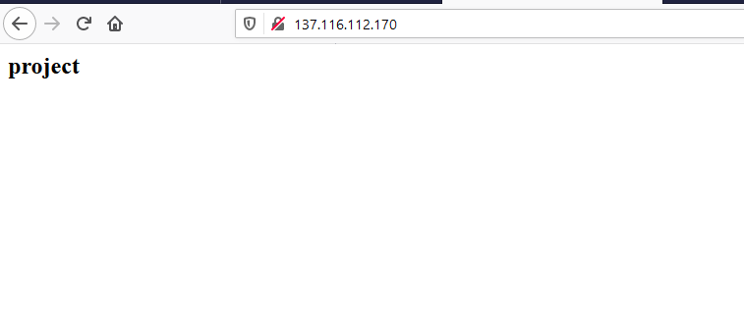
Testing the Project.
Accessing the application using the Ip of docker VM which is created using ansible Playbook
All the ansible ,terraform and application scripts can be accessed here.

Slide 10
Summary:
When the developer commits and push the code to github the pipeline when we created to create the pipeline will we called with the use of github webhook.
After the completion of Pipeline 1 the pipeline 2 will be called automatically with the help of parent child relationship between them.
At the end of pipeline 2 a new VM will be created in azure environment and docker image which we created at the end of pipeline 1 will be pulled and published with docker continer.

Slide 11
Thank you!!

